Slide 1
Network Security Essentials
Chapter 2
Fourth Edition
by William Stallings
Notes:
Lecture slides by Lawrie Brown for “Network Security Essentials”, 4/e, by William Stallings, Chapter 2 – “Symmetric Encryption and Message Confidentiality”.

Slide 2
Outline
Symmetric encryption
Block encryption algorithms
Stream ciphers
Block cipher modes of operations

Slide 3
Symmetric Encryption
or conventional / private-key / single-key
sender and recipient share a common key
all classical encryption algorithms are private-key
was only type prior to invention of public-key in 1970’s
and by far most widely used
Notes:
Symmetric encryption, also referred to as conventional encryption or single-key encryption, was the only type of encryption in use prior to the development of public-key encryption in the 1970s. It remains by far the most widely used of the two types of encryption. All traditional schemes are symmetric / single key / private-key encryption algorithms, with a single key, used for both encryption and decryption. Since both sender and receiver are equivalent, either can encrypt or decrypt messages using that common key.

Slide 4
Some Basic Terminology
plaintext - original message
ciphertext - coded message
cipher - algorithm for transforming plaintext to ciphertext
key - info used in cipher known only to sender/receiver
encipher (encrypt) - converting plaintext to ciphertext
decipher (decrypt) - recovering ciphertext from plaintext
cryptography - study of encryption principles/methods
cryptanalysis (codebreaking) - study of principles/ methods of deciphering ciphertext without knowing key
cryptology - field of both cryptography and cryptanalysis
Notes:
Briefly review some terminology used throughout the course.

Slide 5
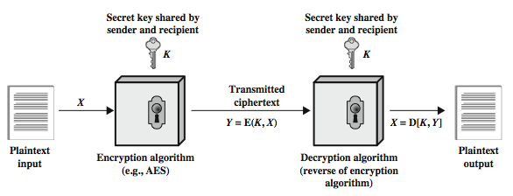
Symmetric Cipher Model
Notes:
Detail the five ingredients of the symmetric cipher model, shown in Stallings Figure 2.1:
plaintext - original message
encryption algorithm – performs substitutions/transformations on plaintext
secret key – control exact substitutions/transformations used in encryption algorithm
ciphertext - scrambled message
decryption algorithm – inverse of encryption algorithm

Slide 6
Requirements
two requirements for secure use of symmetric encryption:
  a strong encryption algorithm
  a secret key known only to sender / receiver
mathematically have:
  Y = E(K, X)
  X = D(K, Y)
assume encryption algorithm is known
implies a secure channel to distribute key
Notes:
There are two requirements for secure use of conventional encryption that mean we assume that it is impractical to decrypt a message on the basis of the cipher- text plus knowledge of the encryption/decryption algorithm, and hence do not need to keep the algorithm secret; rather we only need to keep the key secret. This feature of symmetric encryption is what makes it feasible for widespread use. It allows easy distribution of s/w and h/w implementations.
Can take a closer look at the essential elements of a symmetric encryption scheme: mathematically it can be considered a pair of functions with: plaintext X, ciphertext Y, key K, encryption algorithm E, decryption algorithm D. The intended receiver, in possession of the key, is able to invert the transformation. An opponent, observing Y but not having access to K or X, may attempt to recover X or K.

Slide 7
Cryptography
can characterize cryptographic system by:
  type of encryption operations used
    substitution
    transposition
    product
  number of keys used
    single-key or private
    two-key or public
  way in which plaintext is processed
    block
    stream
Notes:
Cryptographic systems can be characterized along these three independent dimensions.
The type of operations used for transforming plaintext to ciphertext. All encryption algorithms are based on two general principles: substitution, in which each element in the plaintext (bit, letter, group of bits or letters) is mapped into another element, and transposition, in which elements in the plaintext are rearranged. The fundamental requirement is that no information be lost (that is, that all operations are reversible). Most systems, referred to as product systems, involve multiple stages of substitutions and transpositions.
The number of keys used. If both sender and receiver use the same key, the system is referred to as symmetric, single-key, secret-key, or conventional encryption. If the sender and receiver use different keys, the system is referred to as asymmetric, two-key, or public-key encryption.
The way in which the plaintext is processed. A block cipher processes the input one block of elements at a time, producing an output block for each input block. A stream cipher processes the input elements continuously, producing output one element at a time, as it goes along.

Slide 8
Cryptanalysis
objective to recover key not just message
general approaches:
  cryptanalytic attack
  brute-force attack
if either succeed all key use compromised
Notes:
Typically objective is to recover the key in use rather then simply to recover the plaintext of a single ciphertext. There are two general approaches:
Cryptanalysis: relies on the nature of the algorithm plus perhaps some knowledge of the general characteristics of the plaintext or even some sample plaintext- ciphertext pairs. This type of attack exploits the characteristics of the algorithm to attempt to deduce a specific plaintext or to deduce the key being used.
Brute-force attacks try every possible key on a piece of ciphertext until an intelligible translation into plaintext is obtained. On average,half of all possible keys must be tried to achieve success.
If either type of attack succeeds in deducing the key, the effect is catastrophic: All future and past messages encrypted with that key are compromised.

Slide 9
Cryptanalytic Attacks
ciphertext only
  only know algorithm & ciphertext, is statistical, know or can identify plaintext
known plaintext
  know/suspect plaintext & ciphertext
chosen plaintext
  select plaintext and obtain ciphertext
chosen ciphertext
  select ciphertext and obtain plaintext
chosen text
  select plaintext or ciphertext to en/decrypt
Notes:
Stallings Table 2.1 summarizes the various types of cryptanalytic attacks, based on the amount of information known to the cryptanalyst, from least to most. The most difficult problem is presented when all that is available is the ciphertext only. In some cases, not even the encryption algorithm is known, but in general we can assume that the opponent does know the algorithm used for encryption. Then with increasing information have the other attacks. Generally, an encryption algorithm is designed to withstand a known-plaintext attack.

Slide 10
An encryption scheme: computationally secure if
  The cost of breaking the cipher exceeds the value of information
  The time required to break the cipher exceeds the lifetime of information

Slide 11
Brute Force Search
always possible to simply try every key
most basic attack, proportional to key size
assume either know / recognise plaintext
Key Size (bits) | Number of Alternative Keys | Time required at 1 decryption/µs | Time required at 10⁶ decryptions/µs
32 | 2³² = 4.3 × 10⁹ | 2³¹ µs = 35.8 minutes | 2.15 milliseconds
56 | 2⁵⁶ = 7.2 × 10¹⁶ | 2⁵⁵ µs = 1142 years | 10.01 hours
128 | 2¹²⁸ = 3.4 × 10³⁸ | 2¹²⁷ µs = 5.4 × 10²⁴ years | 5.4 × 10¹⁸ years
168 | 2¹⁶⁸ = 3.7 × 10⁵⁰ | 2¹⁶⁷ µs = 5.9 × 10³⁶ years | 5.9 × 10³⁰ years
26 characters (permutation) | 26! = 4 × 10²⁶ | 2 × 10²⁶ µs = 6.4 × 10¹² years | 6.4 × 10⁶ years
Notes:
A brute-force attack involves trying every possible key until an intelligible translation of the ciphertext into plaintext is obtained. On average, half of all possible keys must be tried to achieve success. Stallings Table 2.2 shows how much time is required to conduct a brute-force attack, for various common key sizes (DES is 56, AES is 128, Triple-DES is 168, plus general mono-alphabetic cipher), where either a single system or a million parallel systems, are used.

Slide 12
Feistel Cipher Structure
Horst Feistel devised the feistel cipher
  based on concept of invertible product cipher
partitions input block into two halves
  process through multiple rounds which
  perform a substitution on left data half
  based on round function of right half & subkey
  then have permutation swapping halves
implements Shannon’s S-P net concept
Notes:
Horst Feistel, working at IBM Thomas J Watson Research Labs devised a suitable invertible cipher structure in early 70's.
One of Feistel's main contributions was the invention of a suitable structure which adapted Shannon's S-P network in an easily inverted structure. It partitions input block into two halves which are processed through multiple rounds which perform a substitution on left data half, based on round function of right half & subkey, and then have permutation swapping halves. Essentially the same h/w or s/w is used for both encryption and decryption, with just a slight change in how the keys are used. One layer of S-boxes and the following P-box are used to form the round function.

Slide 13
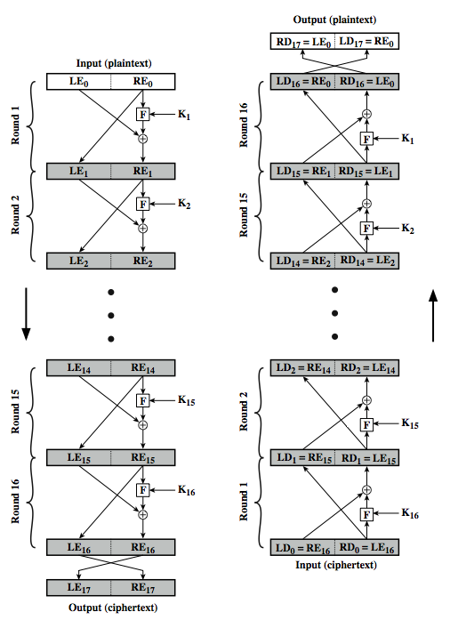
Feistel Cipher Structure
Notes:
Stallings Figure 2.2 illustrates the classical feistel cipher structure, with data split in 2 halves, processed through a number of rounds which perform a substitution on left half using output of round function on right half & key, and a permutation which swaps halves, as listed previously. The LHS side of this figure shows the flow during encryption, the RHS in decryption.
The inputs to the encryption algorithm are a plaintext block of length 2w bits and a key K. The plaintext block is divided into two halves, L₀ and R₀. The two halves of the data pass through n rounds of processing and then combine to produce the ciphertext block. Each round i has as inputs L_{i–1} and R_{i–1}, derived from the previous round, as well as a subkey K_{i}, derived from the overall K. In general, the subkeys K are different from K and from each other.
The process of decryption with a Feistel cipher is essentially the same as the encryption process. The rule is as follows: Use the ciphertext as input to the algorithm, but use the subkeys K_{i} in reverse order. That is, use K_{n} in the first round, K_{n–1} in the second round, and so on until K₁ is used in the last round. This is a nice feature because it means we need not implement two different algorithms, one for encryption and one for decryption. See discussion in text for why using the same algorithm with a reversed key order produces the correct result, noting that at every round, the intermediate value of the decryption process is equal to the corresponding value of the encryption process with the two halves of the value swapped.

Slide 14
Feistel Cipher Design Elements
block size: 128 bits
key size: 128 bits
number of rounds: 16
subkey generation algorithm
round function
fast software en/decryption
ease of analysis
Notes:
The exact realization of a Feistel network depends on the choice of the following parameters and design features:
block size - increasing size improves security, but slows cipher
key size - increasing size improves security, makes exhaustive key searching harder, but may slow cipher
number of rounds - increasing number improves security, but slows cipher
subkey generation algorithm - greater complexity can make analysis harder, but slows cipher
round function - greater complexity can make analysis harder, but slows cipher
fast software en/decryption - more recent concern for practical use
ease of analysis - for easier validation & testing of strength

Slide 15
Symmetric Block Cipher Algorithms
DES (Data Encryption Standard)
3DES (Triple DES)
AES (Advanced Encryption Standard)

Slide 16
Data Encryption Standard (DES)
most widely used block cipher in world
adopted in 1977 by NBS (now NIST)
  as FIPS PUB 46
encrypts 64-bit data using 56-bit key
has widespread use
has considerable controversy over its security
Notes:
The most widely used private key block cipher, is the Data Encryption Standard (DES). It was adopted in 1977 by the National Bureau of Standards as Federal Information Processing Standard 46 (FIPS PUB 46). DES encrypts data in 64-bit blocks using a 56-bit key. The DES enjoys widespread use. It has also been the subject of much controversy its security.

Slide 17
DES History
IBM developed Lucifer cipher
  by team led by Feistel in late 60’s
  used 64-bit data blocks with 128-bit key
then redeveloped as a commercial cipher with input from NSA and others
in 1973 NBS issued request for proposals for a national cipher standard
IBM submitted their revised Lucifer which was eventually accepted as the DES
Notes:
In the late 1960s, IBM set up a research project in computer cryptography led by Horst Feistel. The project concluded in 1971 with the development of the LUCIFER algorithm. LUCIFER is a Feistel block cipher that operates on blocks of 64 bits, using a key size of 128 bits.
Because of the promising results produced by the LUCIFER project, IBM embarked on an effort, headed by Walter Tuchman and Carl Meyer, to develop a marketable commercial encryption product that ideally could be implemented on a single chip. It involved not only IBM researchers but also outside consultants and technical advice from NSA. The outcome of this effort was a refined version of LUCIFER that was more resistant to cryptanalysis but that had a reduced key size of 56 bits, to fit on a single chip.
In 1973, the National Bureau of Standards (NBS) issued a request for proposals for a national cipher standard. IBM submitted the modified LUCIFER. It was by far the best algorithm proposed and was adopted in 1977 as the Data Encryption Standard.

Slide 18
DES Design Controversy
although DES standard is public, considerable controversy over design
  in choice of 56-bit key (vs Lucifer 128-bit)
  and because design criteria were classified
subsequent events and public analysis show in fact design was appropriate
use of DES has flourished
  especially in financial applications
  still standardised for legacy application use
Notes:
Before its adoption as a standard, the proposed DES was subjected to intense & continuing criticism over the size of its key & the classified design criteria.
Recent analysis has shown despite this controversy, that DES is well designed. DES is theoretically broken using Differential or Linear Cryptanalysis but in practise is unlikely to be a problem yet. Also rapid advances in computing speed though have rendered the 56 bit key susceptible to exhaustive key search, as predicted by Diffie & Hellman.
DES has flourished and is widely used, especially in financial applications. It is still standardized for legacy systems, with either AES or triple DES for new applications.

Slide 19
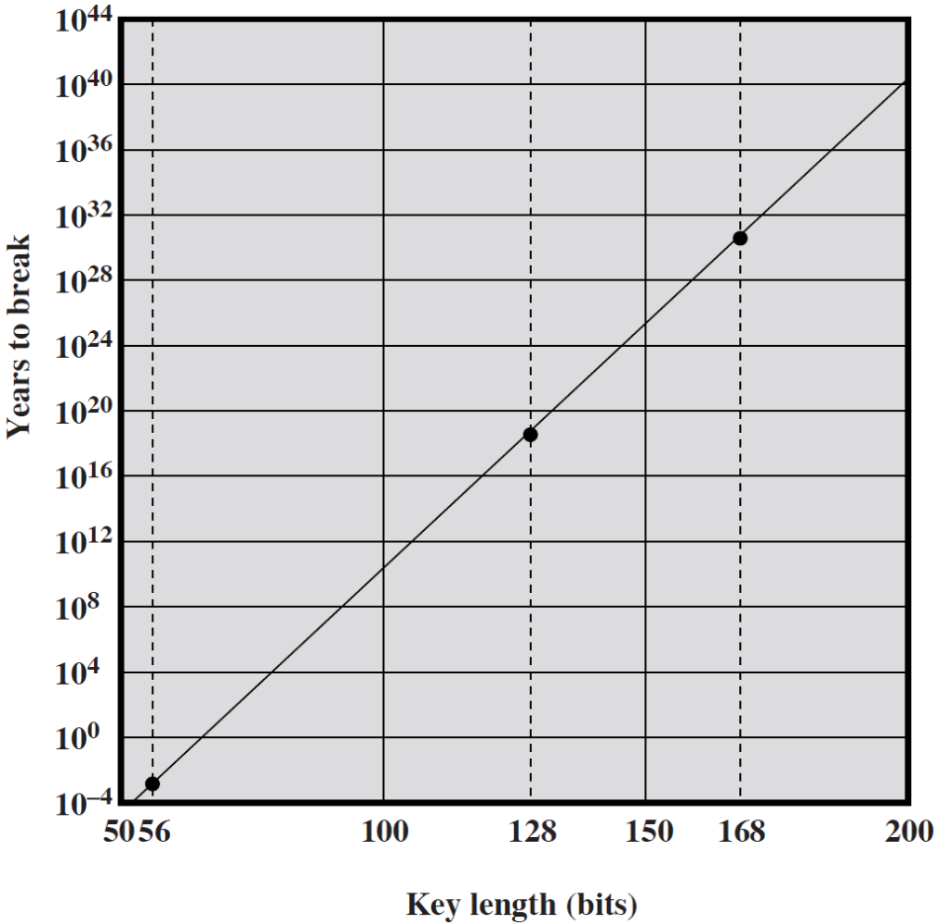
Time to Break a DES Code (assuming 10⁶ decryptions/μs)

Slide 20
Multiple Encryption & DES
clear a replacement for DES was needed
  theoretical attacks that can break it
  demonstrated exhaustive key search attacks
AES is a new cipher alternative
  prior to this alternative was to use multiple encryption with DES implementations
  Triple-DES is the chosen form
Notes:
Given the potential vulnerability of DES to a brute-force attack,there has been considerable interest in finding an alternative. One approach is to design a completely new algorithm, of which AES is a prime example. Another alternative, which would preserve the existing investment in software and equipment, is to use multiple encryption with DES and multiple keys. We examine the widely accepted triple DES (3DES) approach.

Slide 21
Double-DES?
could use 2 DES encrypts on each block
  C = E_{K2}(E_{K1}(P))
issue of reduction to single stage
and have “meet-in-the-middle” attack
  works whenever use a cipher twice
  since X = E_{K1}(P) = D_{K2}(C)
  attack by encrypting P with all keys and store
  then decrypt C with keys and match X value
  takes O(2⁵⁶) steps
Notes:
The simplest form of multiple encryption has two encryption stages and two keys - Double-DES.
Have concern that there might be a single key that is equivalent to using 2 keys as above, not likely but only finally proved as impossible in 1992.
More seriously have the “meet-in-the-middle” attack, first described by Diffie in 1977. It is a known plaintext attack (ie have know pair (P,C), and attempts to find by trial-and-error a value X in the “middle” of the double-DES encryption of this pair, and chances of this are much better at O(2^56) than exhaustive search at O(2^112).

Slide 22
Triple-DES with Two-Keys
hence must use 3 encryptions
  would seem to need 3 distinct keys
but can use 2 keys with E-D-E sequence
  C = E_{K1}(D_{K2}(E_{K1}(P)))
  nb encrypt & decrypt equivalent in security
  if K1=K2 then can work with single DES
standardized in ANSI X9.17 & ISO8732
no current known practical attacks
  several proposed impractical attacks might become basis of future attacks
Notes:
Triple-DES with two keys is a popular alternative to single-DES, but suffers from being 3 times slower to run. The use of encryption & decryption stages are equivalent, but the chosen structure allows for compatibility with single-DES implementations. 3DES with two keys is a relatively popular alternative to DES and has been adopted for use in the key management standards ANS X9.17 and ISO 8732. Currently, there are no practical cryptanalytic attacks on 3DES. Coppersmith notes that the cost of a brute-force key search on 3DES is on the order of 2^112 (=5*10^33) and estimates that the cost of differential cryptanalysis suffers an exponential growth, compared to single DES, exceeding 10^52.
There are several proposed attacks on 3DES that, although not currently practical, give a flavor for the types of attacks that have been considered and that could form the basis for more successful future attacks. See text for details.

Slide 23
Triple-DES with Three-Keys
although no practical attacks on two-key Triple-DES have some concerns
  Two-key: key length = 56*2 = 112 bits
  Three-key: key length = 56*3 = 168 bits
can use Triple-DES with Three-Keys to avoid even these
  C = E_{K3}(D_{K2}(E_{K1}(P)))
has been adopted by some Internet applications, eg PGP, S/MIME
Notes:
Although the attacks currently known appear impractical, anyone using two-key 3DES may feel some concern. Thus, many researchers now feel that three-key 3DES is the preferred alternative. Three-key 3DES has an effective key length of 168 bits and is defined as shown. A number of Internet-based applications have adopted three-key 3DES, including PGP and S/MIME.

Slide 24
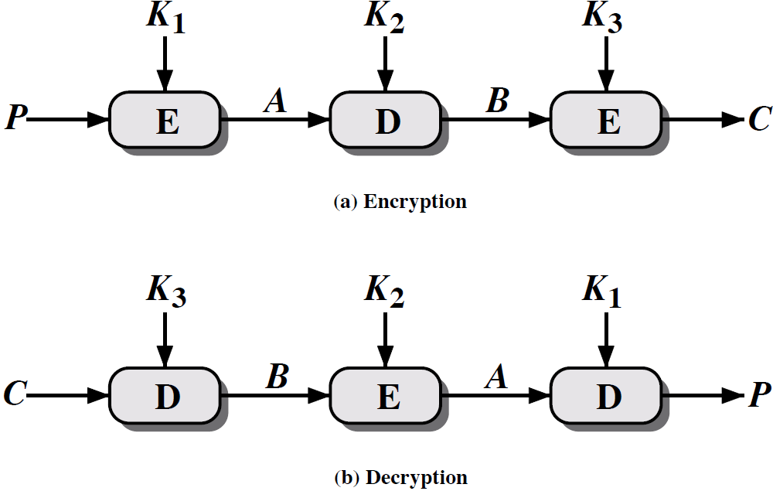
Triple DES

Slide 25
Origins
clearly a replacement for DES was needed
  have theoretical attacks that can break it
  have demonstrated exhaustive key search attacks
can use Triple-DES – but slow, has small blocks
US NIST issued call for ciphers in 1997
15 candidates accepted in Jun 98
5 were shortlisted in Aug-99
Rijndael was selected as the AES in Oct-2000
issued as FIPS PUB 197 standard in Nov-2001
Notes:
The Advanced Encryption Standard (AES) was published by NIST (National Institute of Standards and Technology) in 2001. AES is a symmetric block cipher that is intended to replace DES as the approved standard for a wide range of applications. The AES cipher (& other candidates) form the latest generation of block ciphers, and now we see a significant increase in the block size - from the old standard of 64-bits up to 128-bits; and keys from 128 to 256-bits. In part this has been driven by the public demonstrations of exhaustive key searches of DES. Whilst triple-DES is regarded as secure and well understood, it is slow, especially in s/w. In a first round of evaluation, 15 proposed algorithms were accepted. A second round narrowed the field to 5 algorithms. NIST completed its evaluation process and published a final standard (FIPS PUB 197) in November of 2001. NIST selected Rijndael as the proposed AES algorithm. The two researchers who developed and submitted Rijndael for the AES are both cryptographers from Belgium: Dr. Joan Daemen and Dr.Vincent Rijmen.

Slide 26
The AES Cipher - Rijndael
designed by Rijmen-Daemen in Belgium
has 128/192/256 bit keys, 128 bit data
an iterative rather than feistel cipher
  processes data as block of 4 columns of 4 bytes
  operates on entire data block in every round
designed to be:
  resistant against known attacks
  speed and code compactness on many CPUs
  design simplicity
Notes:
The Rijndael proposal for AES defined a cipher in which the block length and the key length can be independently specified to be 128,192,or 256 bits. The AES specification uses the same three key size alternatives but limits the block length to 128 bits. Rijndael is an academic submission, based on the earlier Square cipher, from Belgium academics Dr Joan Daemen and Dr Vincent Rijmen. It is an iterative cipher (operates on entire data block in every round) rather than feistel (operate on halves at a time), and was designed to have characteristics of: Resistance against all known attacks, Speed and code compactness on a wide range of platforms, & Design simplicity.

Slide 27
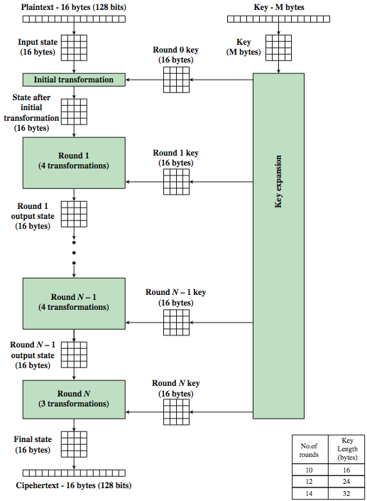
AES Encryption Process
Notes:
The overall encryption process in AES.

Slide 28
AES Structure
data block of 4 columns of 4 bytes is state
key is expanded to array of words
has 9/11/13 rounds in which state undergoes:
  byte substitution (1 S-box used on every byte)
  shift rows (permute bytes between groups/columns)
  mix columns (subs using matrix multiply of groups)
  add round key (XOR state with key material)
  view as alternating XOR key & scramble data bytes
initial XOR key material & incomplete last round
with fast XOR & table lookup implementation
Notes:
The input to the AES encryption and decryption algorithms is a single 128-bit block, depicted in FIPS PUB 197, as a square matrix of bytes .This block is copied into the State array, which is modified at each stage of encryption or decryption. After the final stage, State is copied to an output.
The key is expanded into 44/52/60 lots of 32-bit words (see later), with 4 used in each round. Note that the ordering of bytes within a matrix is by column. So, for example, the first four bytes of a 128-bit plaintext input to the encryption cipher occupy the first column of the in matrix, the second four bytes occupy the second column, and so on. Similarly, the first four bytes of the expanded key, which form a word, occupy the first column of the w matrix.
The data computation then consists of an “add round key” step, then 9/11/13 rounds with all 4 steps, and a final 10th/12th/14th step of byte subs + mix cols + add round key. This can be viewed as alternating XOR key & scramble data bytes operations. All of the steps are easily reversed, and can be efficiently implemented using XOR’s & table lookups.

Slide 29

AES Structure
Notes:
Stallings Figure 2.5 shows the structure of AES in more detail. The cipher consists of N rounds, where the number of rounds depends on the key length: 10 rounds for a 16-byte key; 12 rounds for a 24-byte key; and 14 rounds for a 32-byte key. The first N – 1 rounds consist of four distinct transformation functions: SubBytes, ShiftRows, MixColumns, and AddRoundKey, which are described subsequently. The final round contains only 3 transformation, and there is a initial single transformation (AddRoundKey) before the first round, which can be considered Round 0. Each transformation takes one or more 4 x 4 matrices as input and produces a 4 x 4 matrix as output. Figure 5.1 shows that the output of each round is a 4 x 4 matrix, with the output of the final round being the ciphertext. Also, the key expansion function generates N + 1 round keys, each of which is a distinct 4 x 4 matrix. Each round key serve as one of the inputs to the AddRoundKey transformation in each round.

Slide 30

AES Round
Notes:
Can thus now view all the internal details of the AES round, showing how each byte of the state is manipulated, as shown in Stallings Figure 2.6.

Slide 31
Random Numbers
many uses of random numbers in cryptography
  nonces in authentication protocols to prevent replay
  session keys
  public key generation
  keystream for a one-time pad
in all cases its critical that these values be
  statistically random, uniform distribution, independent
  unpredictability of future values from previous values
true random numbers provide this
care needed with generated random numbers
Notes:
Random numbers play an important role in the use of encryption for various network security applications. In this section, we provide a brief overview of the use of random numbers in cryptography and network security and then focus on the principles of pseudorandom number generation. Getting good random numbers is important, but difficult. You don't want someone guessing the key you're using to protect your communications because your "random numbers" weren't (as happened in an early release of Netscape SSL). Traditionally, the concern in the generation of a sequence of allegedly random numbers has been that the sequence of numbers be random in some well-defined statistical sense (with uniform distribution & independent). In applications such as reciprocal authentication, session key generation, and stream ciphers, the requirement is not just that the sequence of numbers be statistically random but that the successive members of the sequence are unpredictable (so that it is not possible to predict future values having observed previous values). With "true" random sequences, each number is statistically independent of other numbers in the sequence and therefore unpredictable. However, as is discussed shortly, true random numbers are seldom used; rather, sequences of numbers that appear to be random are generated by some algorithm.

Slide 32
Pseudorandom Number Generators (PRNGs)
often use deterministic algorithmic techniques to create “random numbers”
  although are not truly random
  can pass many tests of “randomness”
known as “pseudorandom numbers”
created by “Pseudorandom Number Generators (PRNGs)”
Notes:
Cryptographic applications typically make use of deterministic algorithmic techniques for random number generation, producing sequences of numbers that are not statistically random, but if the algorithm is good, the resulting sequences will pass many reasonable tests of randomness. Such numbers are referred to as pseudorandom numbers, created by “Pseudorandom Number Generators (PRNGs)”.

Slide 33
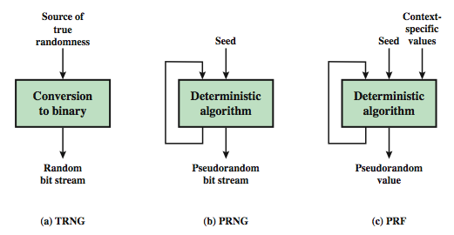
Random & Pseudorandom Number Generators
Notes:
Stallings Figure 2.77 contrasts a true random number generator (TRNG) with two forms of pseudorandom number generators. A TRNG takes as input a source that is effectively random; the source is often referred to as an entropy source. In contrast, a PRNG takes as input a fixed value, called the seed, and produces a sequence of output bits using a deterministic algorithm. Typically, as shown, there is some feedback path by which some of the results of the algorithm are fed back as input as additional output bits are produced. The important thing to note is that the output bit stream is determined solely by the input value or values, so that an adversary who knows the algorithm and the seed can reproduce the entire bit stream.
Figure 7.1 shows two different forms of PRNGs, based on application;
• Pseudorandom number generator: An algorithm that is used to produce an open-ended sequence of bits is referred to as a PRNG. A common application for an open-ended sequence of bits is as input to a symmetric stream cipher, as discussed in Section 7.4. Also, see Figure 3.1a.
• Pseudorandom function (PRF): A PRF is used to produced a pseudorandom string of bits of some fixed length. Examples are the symmetric encryption keys and nonces. Typically, the PRF takes as input a seed plus some context specific values, such as a user ID or an application ID.

Slide 34
PRNG Algorithm Design
Purpose-built algorithms
  E.g. RC4
Algorithms based on existing cryptographic algorithms
  Symmetric block ciphers
  Asymmetric ciphers
  Hash functions and message authentication codes

Slide 35

Stream Cipher Structure
Notes:
Stallings Figure 2.8 illustrates the general structure of a stream cipher, where a key is input to a pseudorandom bit generator that produces an apparently random keystream of bits, and which are XOR’d with message to encrypt it, and XOR’d again to decrypt it by the receiver.

Slide 36
Stream Cipher Properties
some design considerations are:
  long period with no repetitions
  statistically random
  depends on large enough key, e.g. 128 bits
  large linear complexity
properly designed, can be as secure as a block cipher with same size key
but usually simpler & faster
Notes:
[KUMA97] lists the following important design considerations for a stream cipher:
The encryption sequence should have a large period, the longer the period of repeat the more difficult it will be to do cryptanalysis.
The keystream should approximate the properties of a true random number stream as close as possible, the more random-appearing the keystream is, the more randomized the ciphertext is, making cryptanalysis more difficult.
To guard against brute-force attacks, the key needs to be sufficiently long. The same considerations as apply for block ciphers are valid here .Thus, with current technology, a key length of at least 128 bits is desirable.
With a properly designed pseudorandom number generator, a stream cipher can be as secure as block cipher of comparable key length. The primary advantage of a stream cipher is that stream ciphers are almost always faster and use far less code than do block ciphers. A stream cipher can be constructed with any cryptographically strong PRNG.

Slide 37
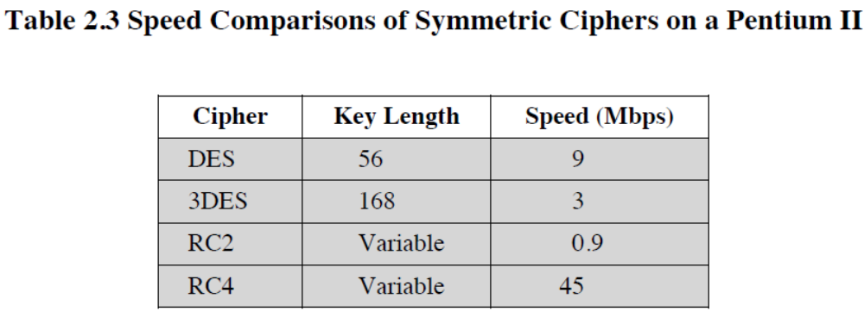

Slide 38
RC4
a proprietary cipher owned by RSA DSI
another Ron Rivest design, simple but effective
variable key size, byte-oriented stream cipher
widely used (web SSL/TLS, wireless WEP/WPA)
key forms random permutation of all 8-bit values
uses that permutation to scramble input info processed a byte at a time
Notes:
RC4 is a stream cipher designed in 1987 by Ron Rivest for RSA Security. It is a variable key-size stream cipher with byte-oriented operations. The algorithm is based on the use of a random permutation. Analysis shows that the period of the cipher is overwhelmingly likely to be greater than 10^100. Eight to sixteen machine operations are required per output byte, and the cipher can be expected to run very quickly in software. RC4 is probably the most widely used stream cipher. It is used in the SSL/TLS secure web protocol, & in the WEP & WPA wireless LAN security protocols. RC4 was kept as a trade secret by RSA Security, but in September 1994 was anonymously posted on the Internet on the Cypherpunks anonymous remailers list. In brief, the RC4 key is ued to form a random permutation of all 8-bit values, it then uses that permutation to scramble input info processed a byte at a time.

Slide 39
RC4 Key Schedule
starts with an array S of numbers: 0..255
use key to well and truly shuffle
S forms internal state of the cipher
  for i = 0 to 255 do
    S[i] = i;
    T[i] = K[i mod keylen];
  j = 0
  for i = 0 to 255 do
    j = (j + S[i] + T[i]) (mod 256);
    swap (S[i], S[j]);
Notes:
The RC4 algorithm is remarkably simple and quite easy to explain. It uses a variable-length key of from 1 to 256 bytes. The RC4 key schedule initialises the state S to the numbers 0..255, and then walks through each entry in turn, using its current value plus the next byte of key to pick another entry in the array, and swaps their values over. After doing this 256 times, the result is a well and truly shuffled array. The total number of possible states is 256! - a truly enormous number, much larger even than the 2048-bit (256*8) max key allowed can select.

Slide 40
RC4 Encryption
encryption continues shuffling array values
sum of shuffled pair selects "stream key" value from permutation
XOR S[t] with next byte of message to en/decrypt
  i = j = 0;
  for each message byte M_{i}
    i = (i + 1) (mod 256);
    j = (j + S[i]) (mod 256);
    swap(S[i], S[j]);
    t = (S[i] + S[j]) (mod 256);
    C_{i} = M_{i} XOR S[t];
Notes:
To form the stream key for en/decryption (which are identical), RC4 continues to shuffle the permutation array S by continuing to swap each element in turn with some other entry, and using the sum of these two entry values to select another value from the permutation to use as the stream key, which is then XOR’d with the current message byte.

Slide 41
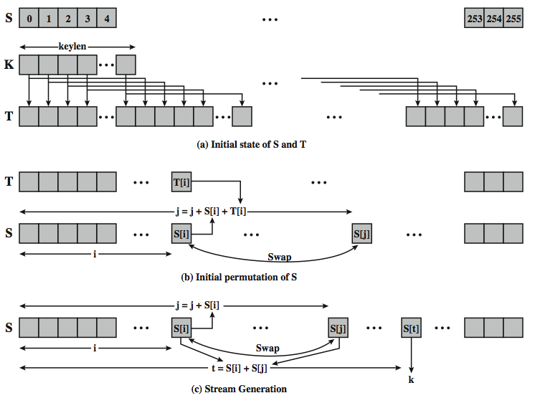
RC4 Overview
Notes:
Stallings Figure 2.9 illustrates the general structure of RC4.

Slide 42
RC4 Security
claimed secure against known attacks
  have some analyses, none practical
result is very non-linear
since RC4 is a stream cipher, must never reuse a key
have a concern with WEP, but due to key handling rather than RC4 itself
Notes:
A number of papers have been published analyzing methods of attacking RC4, but none of these approaches is practical against RC4 with a reasonable key length, such as 128 bits.
A more serious problem occurs in its use in the WEP protocol, not with RC4 itself but the way in which keys are generated for use as input to RC4.
Currently RC4 its regarded as quite secure, if used correctly, with a sufficiently large key.

Slide 43
Modes of Operation
block ciphers encrypt fixed size blocks
  eg. DES encrypts 64-bit blocks with 56-bit key
need some way to en/decrypt arbitrary amounts of data in practise
NIST SP 800-38A defines 5 modes
have block and stream modes
to cover a wide variety of applications
can be used with any block cipher
Notes:
DES (or any block cipher) forms a basic building block, which en/decrypts a fixed sized block of data. However to use these in practise, we usually need to handle arbitrary amounts of data, which may be available in advance (in which case a block mode is appropriate), and may only be available a bit/byte at a time (in which case a stream mode is used). To apply a block cipher in a variety of applications, five "modes of operation" have been defined by NIST (SP 800-38A). In essence, a mode of operation is a technique for enhancing the effect of a cryptographic algorithm or adapting the algorithm for an application, such as applying a block cipher to a sequence of data blocks or a data stream. The five modes are intended to cover a wide variety of applications of encryption for which a block cipher could be used. These modes are intended for use with any symmetric block cipher, including triple DES and AES. .

Slide 44
The Most Important Modes
Electronic Codebook Mode (ECB)
Cipher Block Chaining Mode (CBC)
Cipher Feedback Mode (CFB)
Counter Mode (CTR)

Slide 45
Electronic Codebook Book (ECB)
message is broken into independent blocks which are encrypted
each block is a value which is substituted, like a codebook, hence name
each block is encoded independently of the other blocks
  C_{i} = E_{K}(P_{i})
uses: secure transmission of single values
Notes:
The simplest mode is the electronic codebook (ECB) mode, in which plaintext is handled one block at a time and each block of plaintext is encrypted using the same key. The term codebook is used because, for a given key, there is a unique ciphertext for every b-bit block of plaintext. Therefore, we can imagine a gigantic codebook in which there is an entry for every possible b-bit plaintext pattern showing its corresponding ciphertext. For a message longer than b bits, the procedure is simply to break the message into b-bit blocks, padding the last block if necessary. Decryption is performed one block at a time, always using the same key. ECB is the simplest of the modes, and is used when only a single block of info needs to be sent (eg. a session key encrypted using a master key).

Slide 46
Advantages and Limitations of ECB
message repetitions may show in ciphertext
  if aligned with message block
  particularly with data such as graphics
  or with messages that change very little, which become a code-book analysis problem
weakness is due to the encrypted message blocks being independent
main use is sending a few blocks of data
Notes:
For lengthy messages, the ECB mode may not be secure. If the message is highly structured, it may be possible for a cryptanalyst to exploit these regularities. If the message has repetitive elements, with a period of repetition a multiple of b bits, then these elements can be identified by the analyst. This may help in the analysis or may provide an opportunity for substituting or rearranging blocks. Hence ECB is not appropriate for any quantity of data, since repetitions can be seen, esp. with graphics, and because the blocks can be shuffled/inserted without affecting the en/decryption of each block. Its main use is to send one or a very few blocks, eg a session encryption key.

Slide 47
Cipher Block Chaining (CBC)
message is broken into blocks
linked together in encryption operation
each previous cipher blocks is chained with current plaintext block, hence name
use Initial Vector (IV) to start process
  C_{i} = E_{K}(P_{i} XOR C_{i-1})
  C₀ = IV
uses: bulk data encryption, authentication
Notes:
To overcome the problems of repetitions and order independence in ECB, want some way of making the ciphertext dependent on all blocks before it. The CBC provides this, by combining the previous ciphertext block with the current message block before encrypting. In effect, we have chained together the processing of the sequence of plaintext blocks. The input to the encryption function for each plaintext block bears no fixed relationship to the plaintext block. Therefore, repeating patterns of b bits are not exposed. For decryption, each cipher block is passed through the decryption algorithm. The result is XORed with the preceding ciphertext block to produce the plaintext block. To produce the first block of ciphertext, an initialization vector (IV) is XORed with the first block of plaintext. On decryption, the IV is XORed with the output of the decryption algorithm to recover the first block of plaintext. The IV is a data block that is that same size as the cipher block, and is either well known (often all 0's), or otherwise is sent, ECB encrypted, just before starting CBC use. CBC mode is applicable whenever large amounts of data need to be sent securely, provided that all data is available in advance (eg email, FTP, web etc).

Slide 48
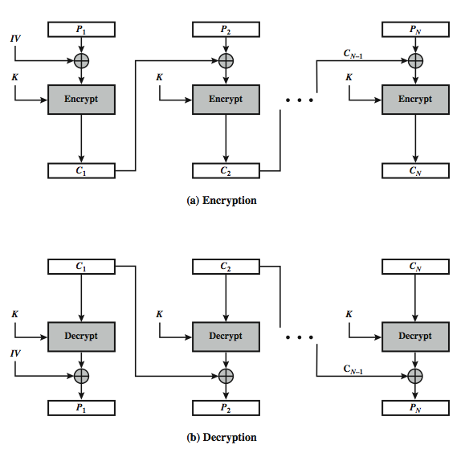
Cipher Block Chaining (CBC)
Notes:
Stallings Figure 2.10 illustrates the Cipher Block Chaining (CBC) Mode.

Slide 49
Cipher FeedBack (CFB)
message is treated as a stream of bits
added to the output of the block cipher
result is feed back for next stage (hence name)
standard allows any number of bit (1,8, 64 or 128 etc) to be fed back
  denoted CFB-1, CFB-8, CFB-64, CFB-128 etc
most efficient to use all bits in block (64 or 128)
  C_{i} = P_{i} XOR E_{K}(C_{i-1})
  C₀ = IV
uses: stream data encryption, authentication
Notes:
Cipher feedback (CFB) mode is one alternative. As with CBC, the units of plaintext are chained together, so that the ciphertext of any plaintext unit is a function of all the preceding plaintext. In this case, rather than units of b bits, the plaintext is divided into segments of s bits. The input to the encryption function is a b-bit shift register that is initially set to some initialization vector (IV). The leftmost (most significant) s bits of the output of the encryption function are XORed with the first segment of plaintext P1 to produce the first unit of ciphertext C1, which is then transmitted. In addition, the contents of the shift register are shifted left by s bits and C1 is placed in the rightmost (least significant) s bits of the shift register. This process continues until all plaintext units have been encrypted. For decryption, the same scheme is used, except that the received ciphertext unit is XORed with the output of the encryption function to produce the plaintext unit. Note that it is the encryption function that is used, not the decryption function.
As originally defined, CFB was to "consume" as much of the "random" output as needed for each message unit (bit/byte) before "bumping" bits out of the buffer and re-encrypting. This is wasteful though, and slows the encryption down as more encryptions are needed. An alternate way to think of it is to generate a block of "random" bits, consume them as message bits/bytes arrive, and when they're used up, only then feed a full block of ciphertext back. This is CFB-64 or CFB-128 mode (depending on the block size of the cipher used eg DES or AES respectively). CFB is the usual choice for quantities of stream oriented data, and for authentication use.

Slide 50
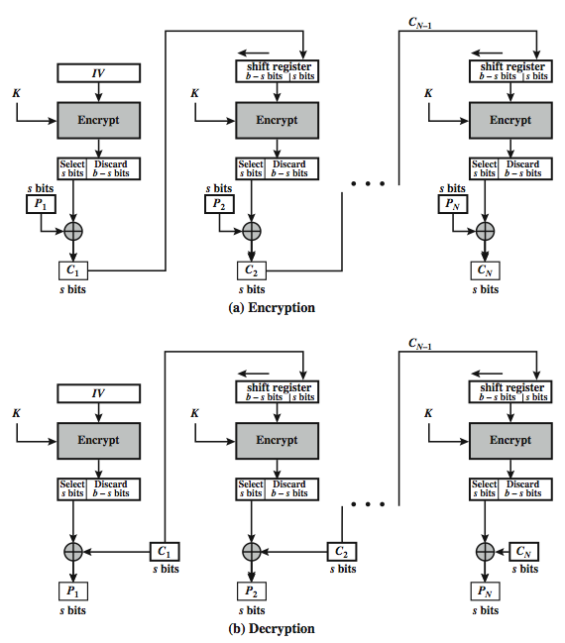
s-bit
Cipher FeedBack (CFB-s)
Notes:
Stallings Figure 2.11 illustrates the operation of s-bit Cipher FeedBack (CFB) Mode.

Slide 51
Advantages and Limitations of CFB
appropriate when data arrives in bits/bytes
most common stream mode
Limitation: need to stall while doing block encryption after every n-bits
note that the block cipher is used in encryption mode at both ends
errors propagate for several blocks after the error
Notes:
CFB is the usual stream mode. As long as can keep up with the input, doing encryptions every 8 bytes. A possible problem is that if its used over a "noisy" link, then any corrupted bit will destroy values in the current and next blocks (since the current block feeds as input to create the random bits for the next). So either must use over a reliable network transport layer (typical) or use OFB/CTR.

Slide 52
Counter (CTR)
a “new” mode, though proposed early on
similar to OFB but encrypts counter value rather than any feedback value
must have a different key & counter value for every plaintext block (never reused)
  O_{i} = E_{K}(i)
  C_{i} = P_{i} XOR O_{i}
uses: high-speed network encryptions
Notes:
The Counter (CTR) mode is a variant of OFB, but which encrypts a counter value (hence name). Although it was proposed many years before, it has only recently been standardized for use with AES along with the other existing 4 modes. It is being used with applications in ATM (asynchronous transfer mode) network security and IPSec (IP security). A counter, equal to the plaintext block size is used. The only requirement stated in SP 800-38A is that the counter value must be different for each plaintext block that is encrypted. Typically the counter is initialized to some value and then incremented by 1 for each subsequent block. As with the OFB mode, the initial counter value must be a nonce; be different for all of the messages encrypted using the same key. Further, all counter values across all messages must be unique. If, contrary to this requirement, a counter value is used multiple times, then the confidentiality of all of the plaintext blocks corresponding to that counter value may be compromised.

Slide 53
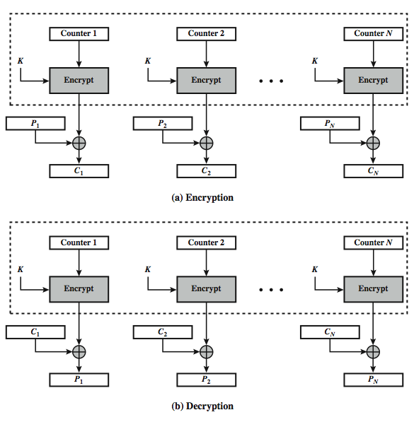
Counter (CTR)
Notes:
Stallings Figure 2.11 illustrates the Counter (CTR) Mode.

Slide 54
Advantages and Limitations of CTR
efficiency
  can do parallel encryptions in h/w or s/w
  can preprocess in advance of need
  good for bursty high speed links
random access to encrypted data blocks
provable security (good as other modes)
but must ensure never reuse key/counter values, otherwise could break (cf OFB)
Notes:
CTR mode has a number of advantages in parallel h/w & s/w efficiency, can preprocess the output values in advance of needing to encrypt, can get random access to encrypted data blocks, and is simple. But like OFB have issue of not reusing the same key+counter value.

Slide 55
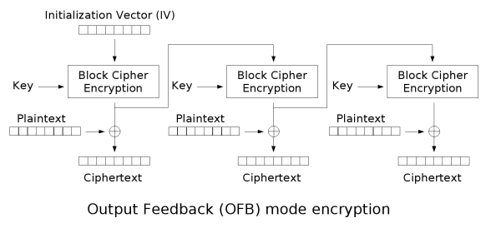
Output Feedback Mode (OFB)

